Slide 1

Day 3 Time For Espresso

Slide 2

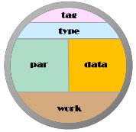
Carabao Shell
interactive
graphical shell
copy & paste
gallery
&
report generation
basket
concept
refresh
&
rebuild
building
blocks

Slide 3
Moving to the Next Level
On day #1 we created a log file analysis tool (using procedural programming style)
Is it possible to convert this analysis tool into a menu based dialog driven analysis tool which
It should supports all the fancy features of the Carabao shell, like mass storage (save and load), data importing and exporting, shell cloning, package

Slide 4

Rapid Prototyping
Motivation
Build a new class derived from the Carabao base class, which inherits all the Carabao functionality.
We would call such kind of object class a strong class with powerful functionality.

Slide 5
Rapid Prototyping
If the creation process of such a strong class would be fast and easy, like making a strong espresso on modern coffee makers, say in less than 30 seconds ...
... well, this would be fantastic.
Such kind of object class could carry the name Espresso – strong, fast and easy.

